Slide 1
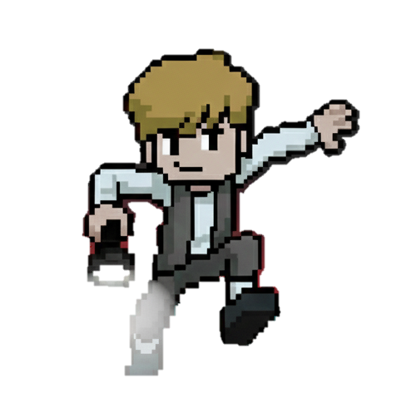
Max and Orchestration Quest
Gamification of Container Orchestration
Lemgo | 03.11.2025 | Team #4
Supervisor: Akshay

Slide 2
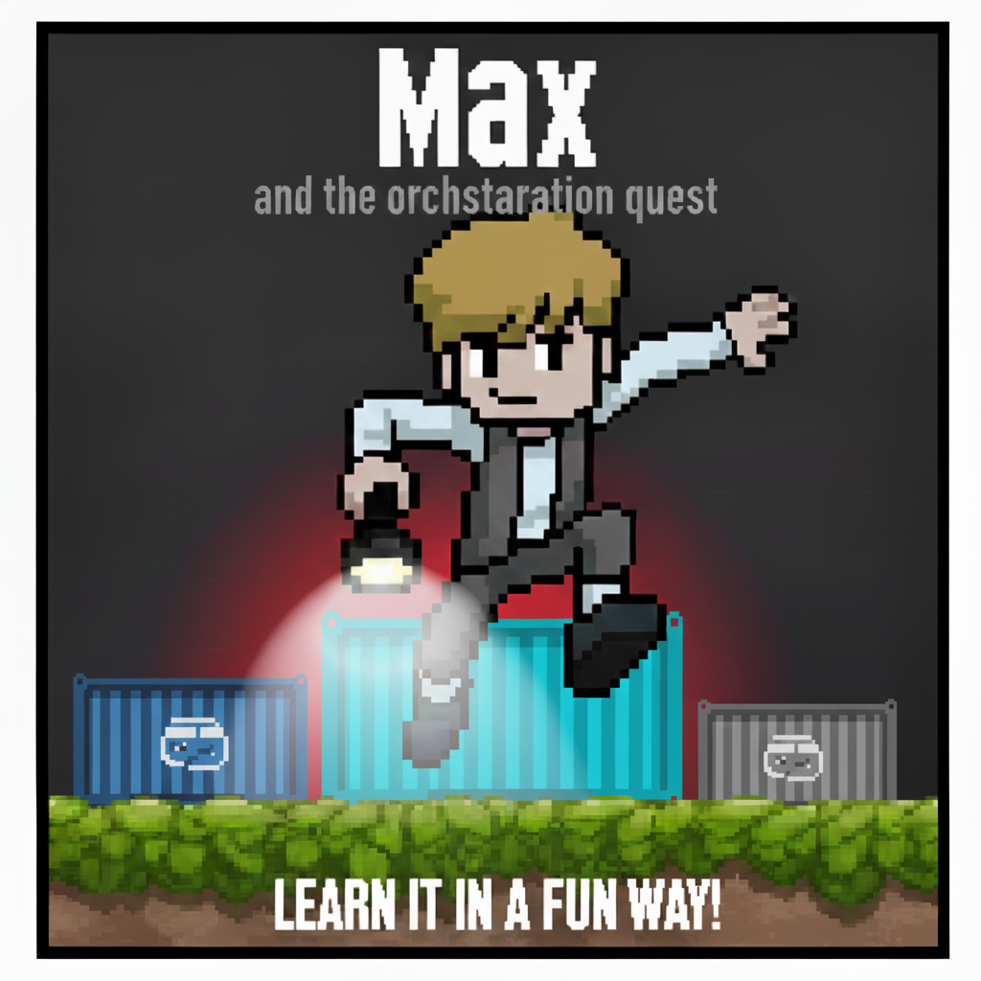

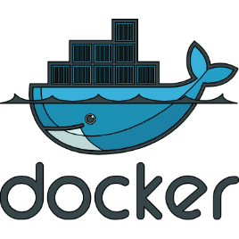
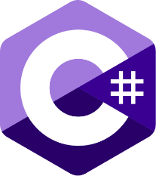

The 2D platformer Max and Orchestration Quest uses Unity to create a retro game interface where the player must physically move and deploy virtual server resources controlled by Docker

Slide 3


Max and Orchestration Quest
📺
Enjoy retro world while actively learning docker orchestration
Meet Team #4
Khaled Rakhisi 20067751

Slide 4
Problem & Motivation
Context: What real-world problem or need are you addressing? complexity and steep learning curve of modern IT infrastructure, specifically container orchestration (like Docker and Kubernetes). A dry text-based command line tool.
Why it matters: Who benefits, and why is it relevant? relevant because mastering orchestration is critical for current software development and DevOps careers. Who benefits? Students: They learn in an easy, interactive and fun way with critical infrastructure tools. Educators: They receive an effective, measurable, and engaging teaching tool.
Evidence or observation: Students frequently feel overwhelmed and lose focus when confronted with command-line interfaces (CLIs); our game turns these abstract deployment steps into a physical, rewarding platformer puzzle.

Slide 5
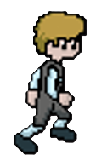
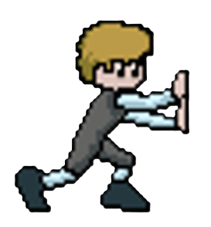
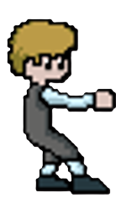
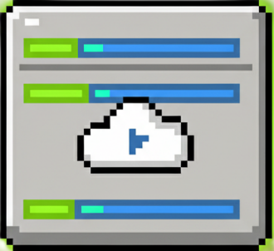
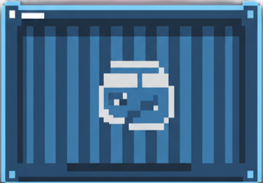
Concept & Core Idea
Main Idea: What is your concept or product? The unique selling point is Max himself, who transforms the complex task of container orchestration into an engaging, physical, narrative puzzle.
Gameplay / Interaction: How does it work? The player (Max) uses platformer mechanics (run, jump, push, pull) to physically move virtual Container Blocks (Docker images like Nginx or Pi-hole) across a level and drop them onto designated VM Nodes to trigger a real deployment command via a Node.js backend.
CPU: 90% RAM: 60% Disk: 20%

Slide 6
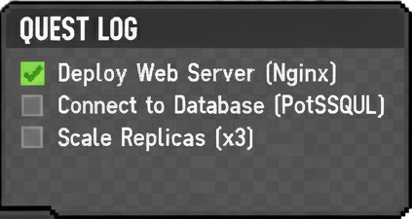
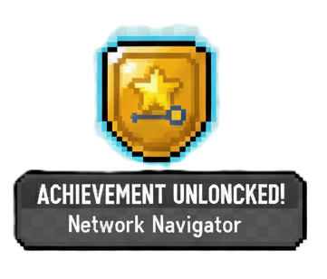
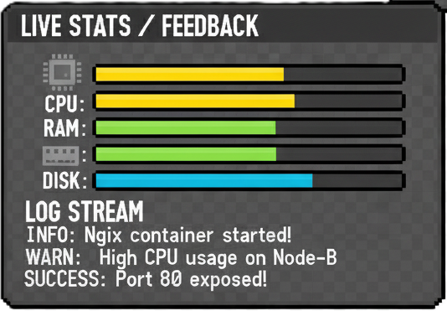
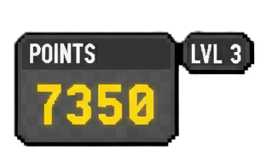
Concept & Core Idea
Gamification elements: points, badges, feedback, challenges

Slide 7
Technical & Creative Approach
Technology: Unity 6.1, C#, node.js, Express.js, docker, AWS/GCP, Vue.js
Roles: Khaled => Unity Shiva => Docker Nafeesa => Game UI/UX and Frontend in web-version Velvin => DevOps Joan => Backend
Feasibility: The first steps in implementation focus on establishing the crucial communication between the game, the server, and the container environment.
Unity → Server → Docker → Unity (real time)
Once this three-step loop is successfully tested, the project is technically feasible. The rest of the work becomes game design (building levels) and UI/UX (creating the health bars).

Slide 8
Reflection & Next Steps
Learnings so far: insights or changes in your understanding
Challenges: what remains open?
Next steps: milestones until prototype or demo
Connection to Gamification Innovation Lab: how your idea fits into the bigger picture

Slide 9


T-Shaped Skills (Team Reflection)
Vertical (Depth): Your individual expertise – what’s your strength? e.g., Programming, Game Design, AI, Electronics, Unity, Unreal
Horizontal (Breadth): What have you learned from other disciplines? e.g., Collaboration, Creativity, Communication, Critical Thinking
Team reflection: How does your group combine depth and breadth for innovation? Where do you need assistance from other Teams? What can you offer to other Teams? Visualize it!
T-shaped professionals combine deep expertise with broad collaboration and creative thinking — essential for innovation and teamwork.
People engage and retain more when they see a clear link between learning and their daily work.
Generalist
Specialist
T-Shaped Innovator
T-Shaped Team
Depth of Expertise
Breadth of Knowledge

Slide 10
Technical Setup & Resource Planning
Software Guidelines
Use only open-source software or licensed tools provided by the university.
Ensure that all team members have access to the required platforms and versions.
Examples: Godot, Unity (Education License), Unreal Engine, Blender, React, Node.js.
Hardware Requirements
Identify whether special hardware is required for your project:
High-performance PCs with dedicated GPUs
VR/AR headsets, sensors, controllers, or simulation rigs
Scope & Availability
Indicate how many systems or devices are needed (e.g., for development, testing, demonstration).
Clarify whether the required equipment is available on campus or needs to be requested.
Alternative Options
Consider practical alternatives such as:
Running desktop simulations instead of VR setups
Using cloud-based GPU environments
Collaborating with other teams or departments to share equipment
🎯 Goal: Use resources efficiently, creatively, and sustainably while ensuring that all teams can work productively.

Slide 11
Pitch Template – Footer Information
PitchRev. ➔ Indicates the current revision number of the presentation. Use it to track progress — presentations can evolve as new insights and results emerge.
Team No. ➔ Identifies your project team.Always include your assigned team number for easy reference.
Project Title ➔ Clearly state your project’s name or working title.This ensures each presentation can be linked to its context at first glance.
Slide Number ➔ Helps your audience take notes or refer to specific slides during Q&A. This is especially useful for feedback sessions and mentoring discussions.
Remember:
The goal is continuous improvement — your “PitchRev.” is not final,
it’s part of your learning and innovation journey.

